Slide 1


Slide 2
PERSONALIZED WORKSPACE AUTOMATION
Group Members
Syed Muhammad Taqi Kazmi 0384-BSCS-20
Supervised By
Sir Yahya Khurram

Slide 3
Introduction
Personalized Workspace Automation is an innovative project that will revolutionize how individuals interact with their digital work environments. By leveraging advanced technologies and intelligent systems, this project seeks to create customized, efficient, and seamless workspaces tailored to the unique needs and preferences of each user. The ultimate goal is to enhance productivity, reduce manual effort, and provide a more intuitive and responsive workspace experience.

Slide 4
Existing System
Traditional systems like Trello offer task boards and automation via Butler, which lacks the deeper personalization and AI-driven support that our system provides.
AI-powered tips and insights through ChatGPT integration, offering personalized guidance for task management.
Advanced reminders via email and SMS, ensuring timely notifications across multiple platforms.
Dynamic status updates that automatically mark tasks as ‘Delivered,' streamlining task tracking.
Full customization of workspace backgrounds, creating a personalized, visually engaging environment.

Slide 5
Problem statement
Many existing workflow systems offer limited personalization options, restricting users from creating a workspace that reflects their preferences and work style.
Current systems often rely on notifications limited to the platform or email, missing out on more flexible options like SMS reminders, leading to missed tasks.
Most platforms do not provide real-time, AI-driven tips or insights to help users optimize their workflow and task management.
Users manually update task status in most systems, which can be time-consuming and prone to human error, reducing productivity.

Slide 6
Proposed System
Users can personalize their workspace by selecting backgrounds, themes, and layouts, creating an environment that suits their preferences.
Integrated ChatGPT offers real-time, personalized guidance and tips to improve productivity, helping users with task prioritization and workflow optimization.
The system automatically marks tasks as ‘Delivered' once the user has finished them, reducing manual input and improving efficiency.
The system provides reminders via both email and SMS, offering flexibility in how users receive notifications and ensuring they stay on top of tasks.

Slide 7
Functional Requirements
Logout
Log in
Reminder Management
Notification Management
Tips and Suggestions
User Management
Task Status Management

Slide 8
Non-Functional Requirements
Reliability
Accessibility
Privacy
Performance Requirements
Safety Requirements
Accessibility
Usability

Slide 9
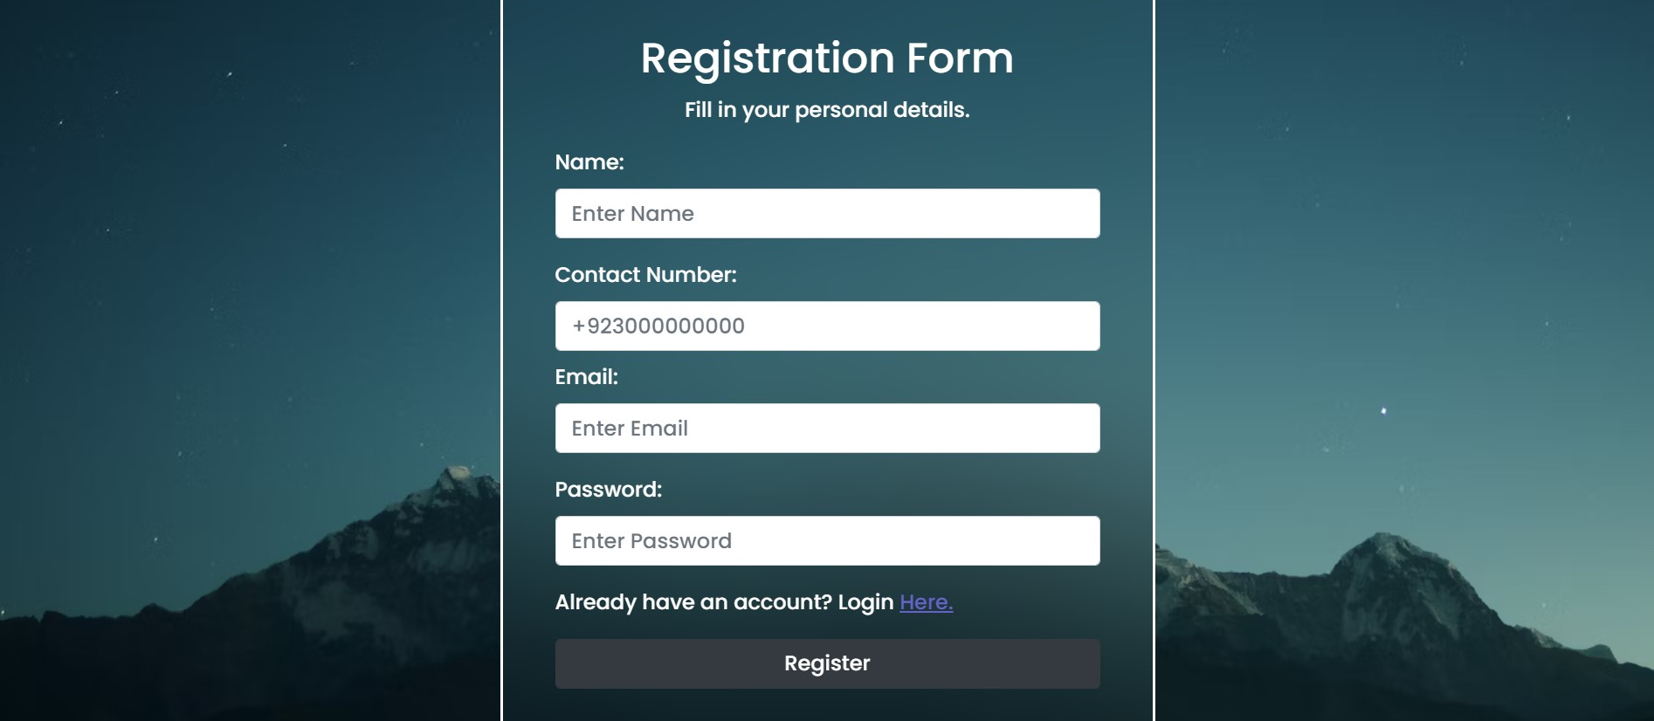

Slide 10
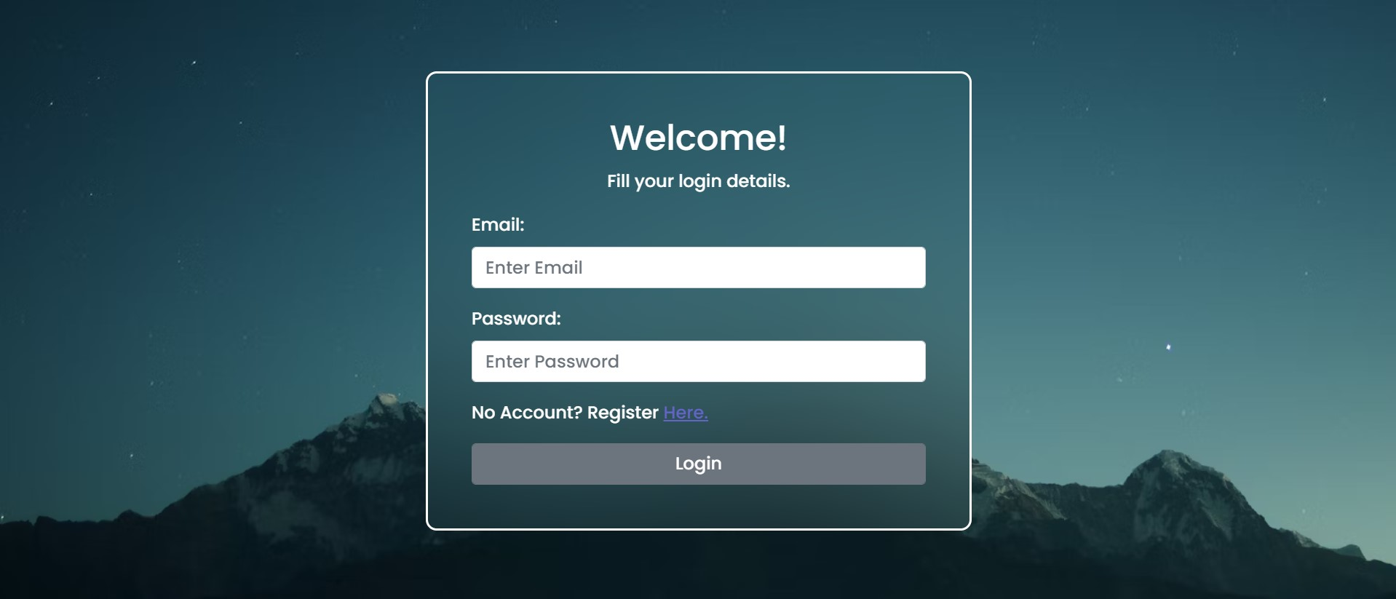

Slide 11
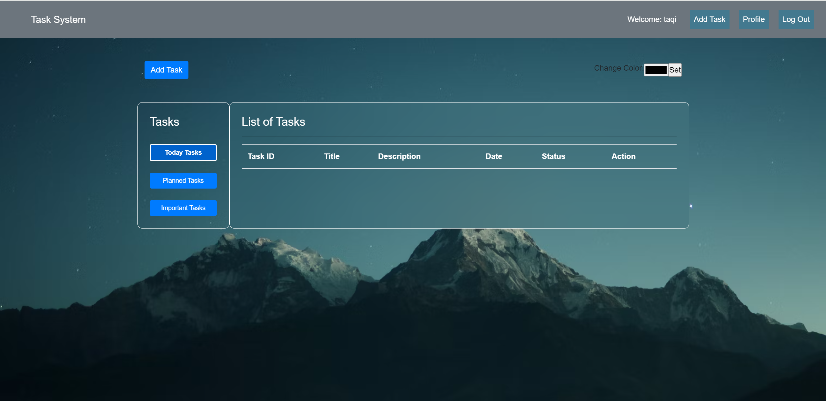

Slide 12
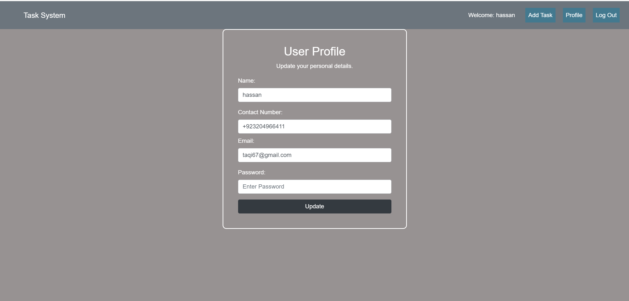

Slide 13
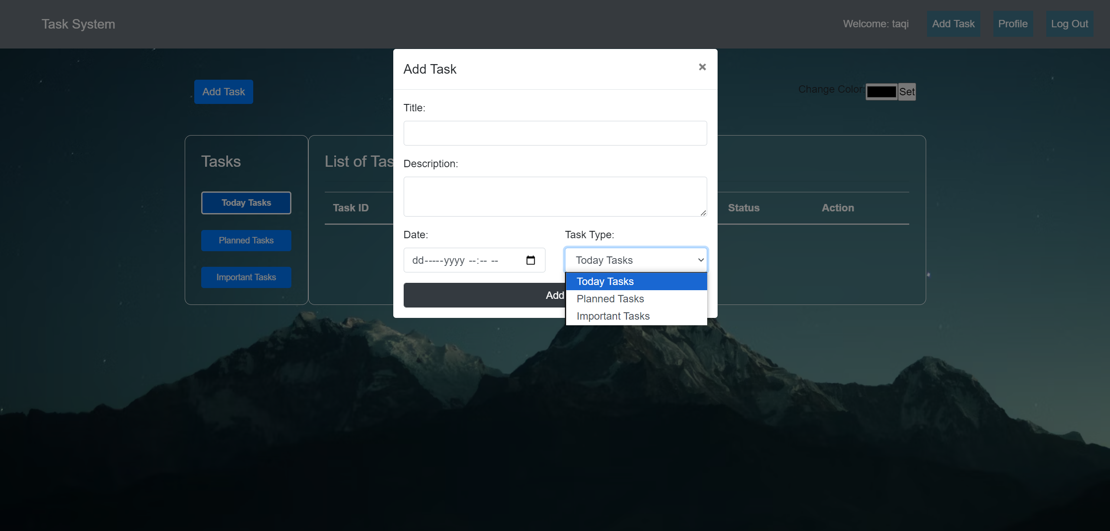

Slide 14
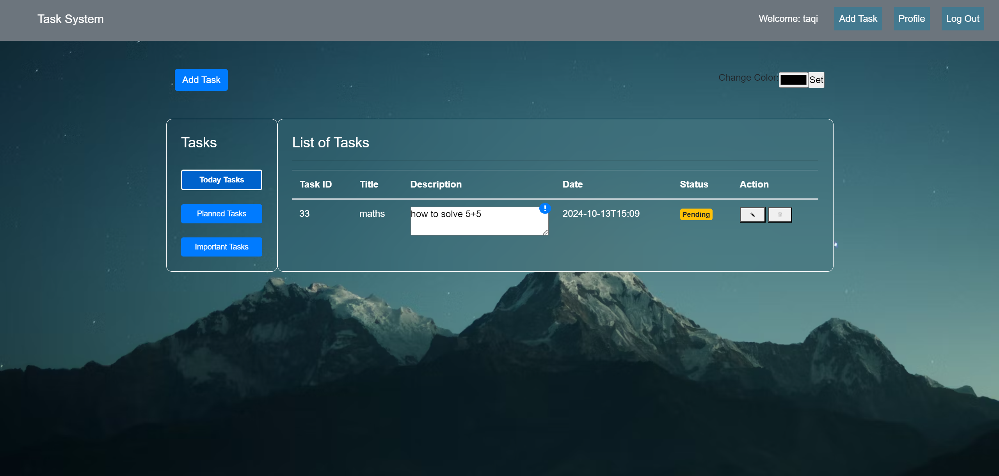

Slide 15
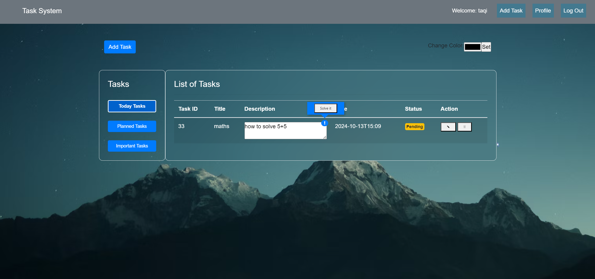

Slide 16
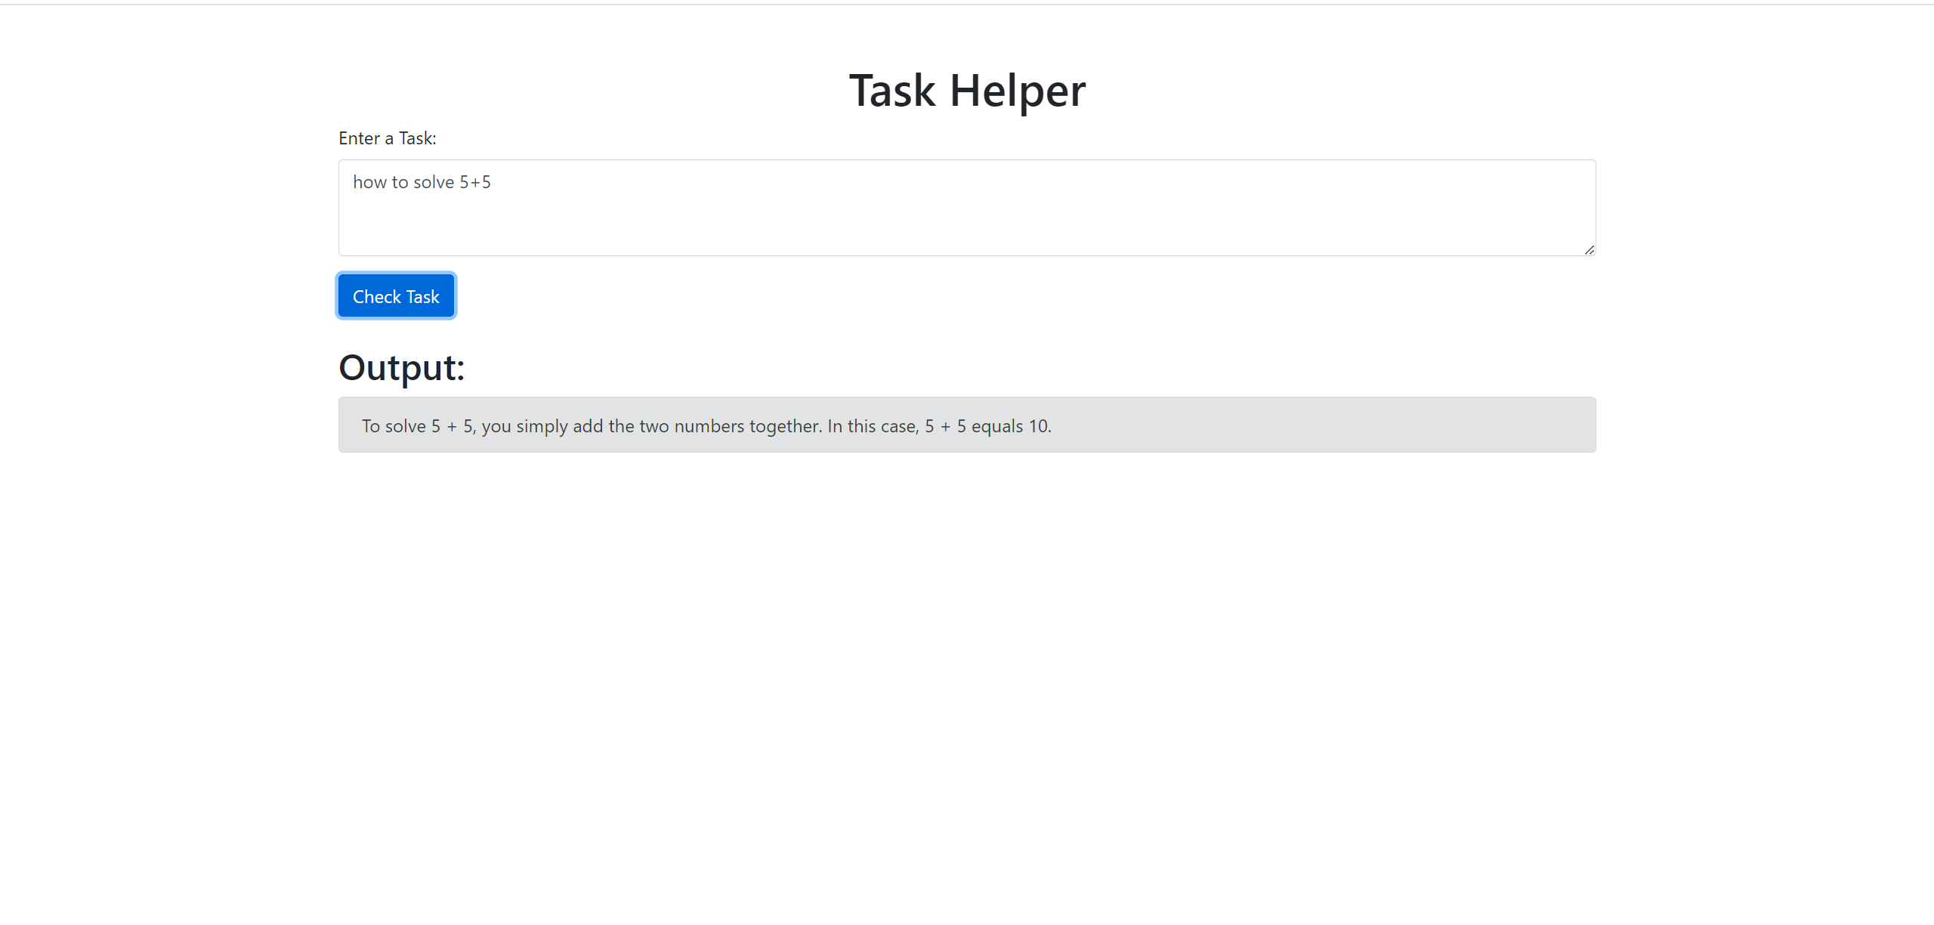

Slide 17
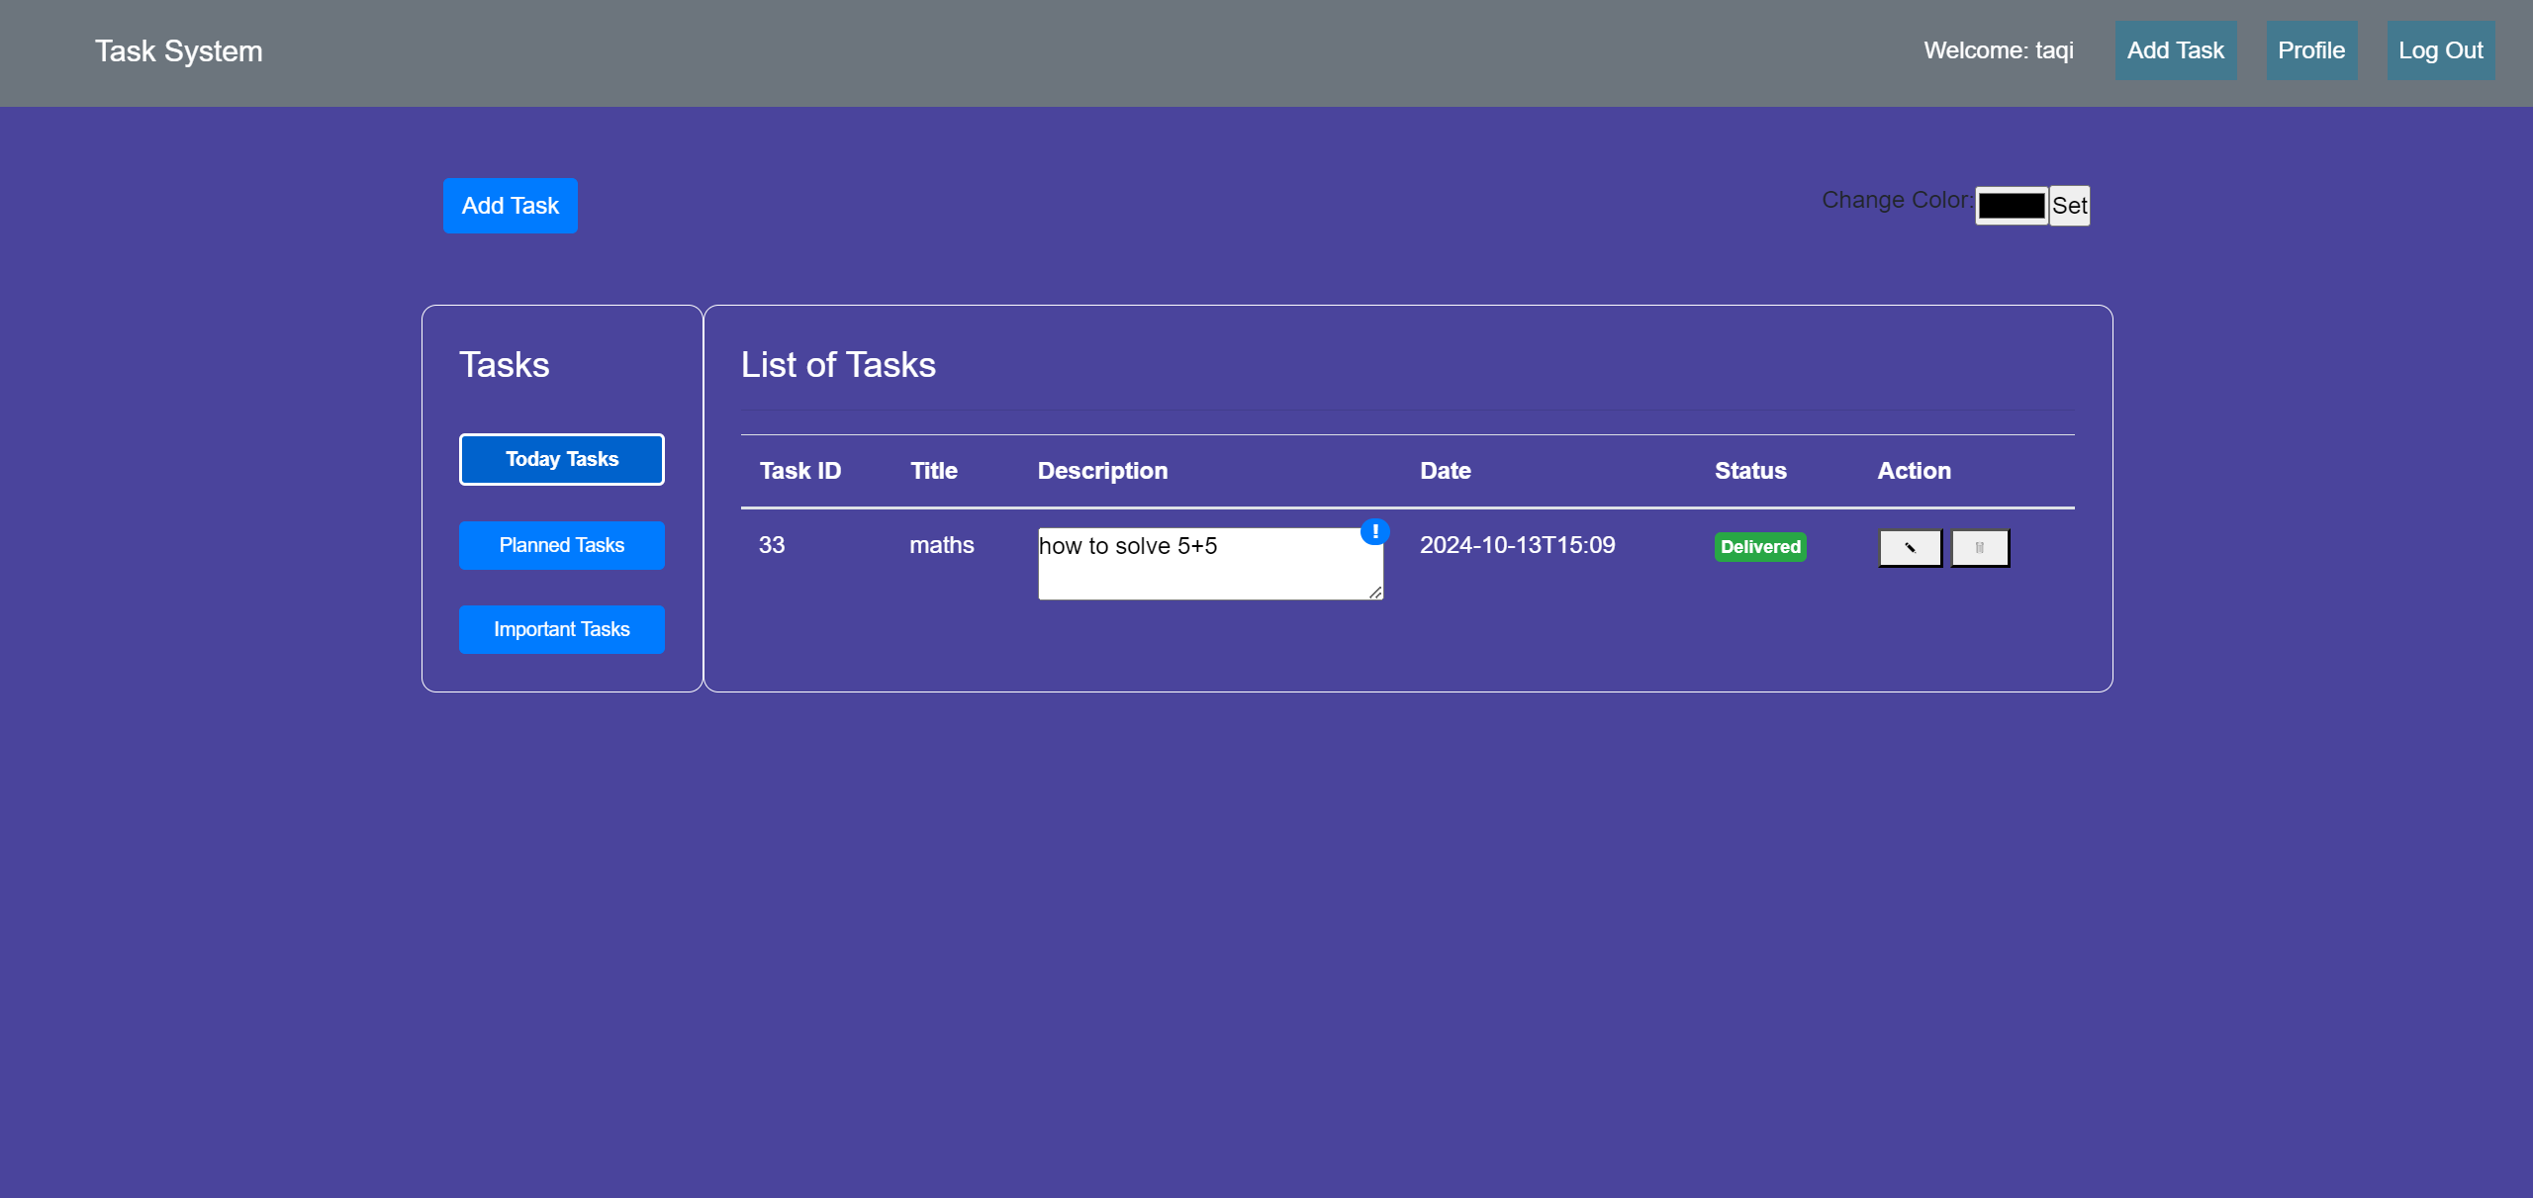

Slide 18
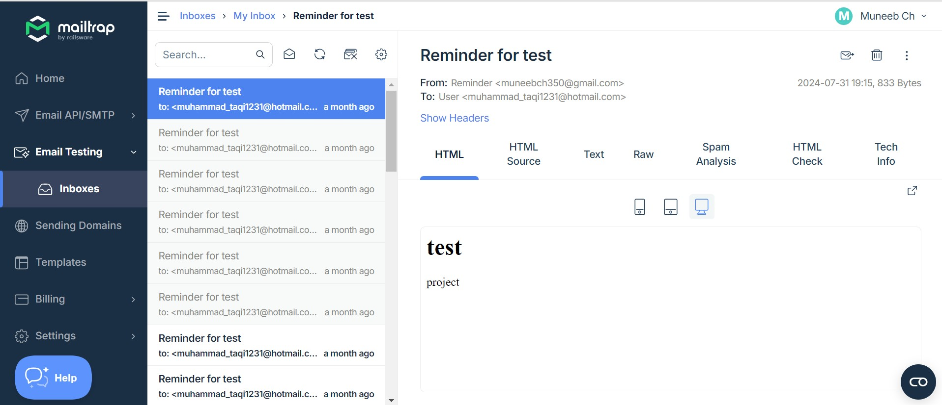

Slide 19
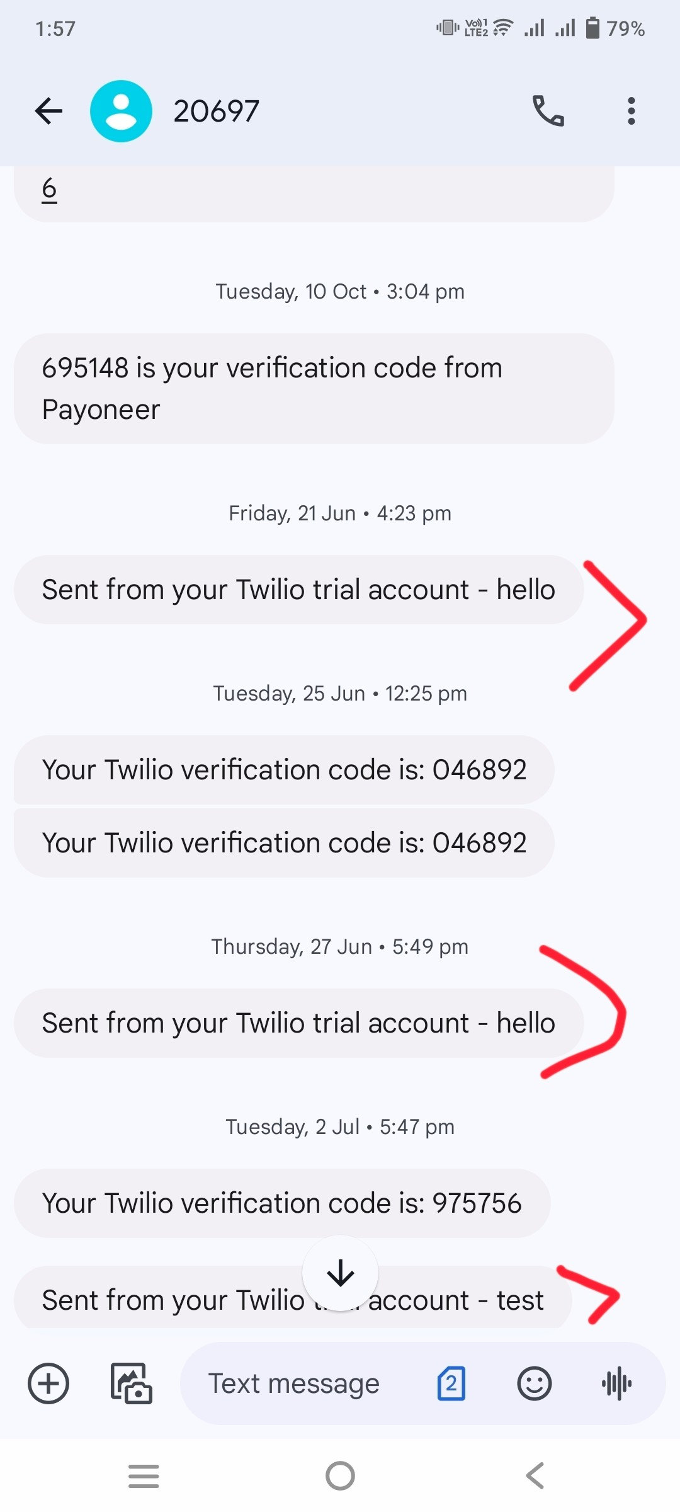

Slide 20
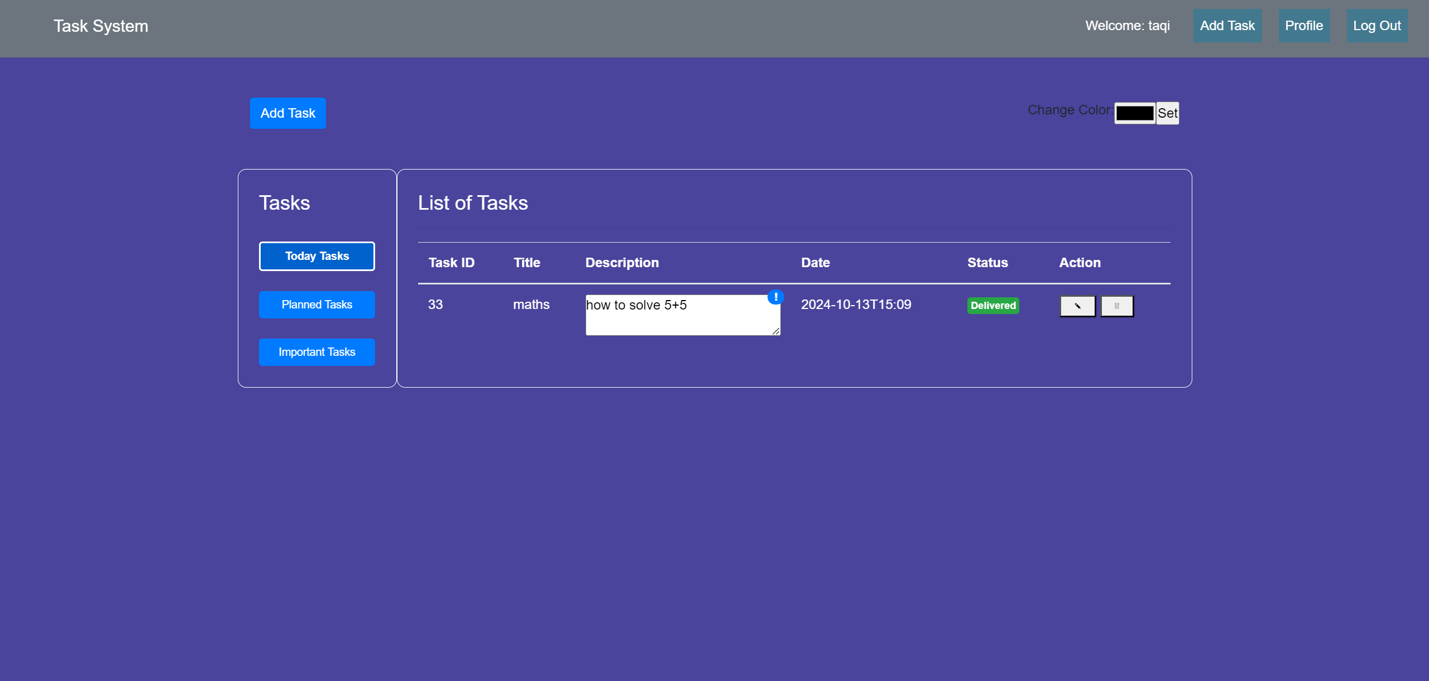

Slide 21
Tools and Technology
Visual Studio Code
HTML
CSS
PHP
Javascript
GitHub
Google Chrome Browser

Slide 22
System Features
Customizable User Interface
Multi-channel Reminders
AI-Driven Task Tips
Automated Task Completion
Sidebar for Quick Navigation
Flexible Scheduling
Progress Tracking
24/7 Availability

Slide 23
User Portals
User

Slide 24
Project Function
1. Functions of User
User can log in using their email and password. Based on the permissions by entering the correct email and password, they can perform various tasks and access detailed information
Managing Tasks
Managing Task categorization
Managing Customizable Workspace
Managing Smart Scheduling

Slide 25
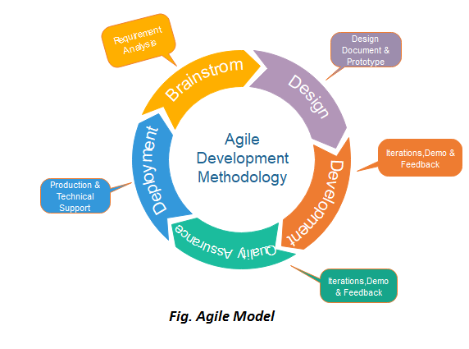
Methodology
The main reason for choosing this technique is that we have only two members in the development team. Our team is too small to choose big and complex process models. We are asked to deliver the prototypes to the administration after some regular intervals.

Slide 26
Project Design
Data Flow Diagram

Slide 27
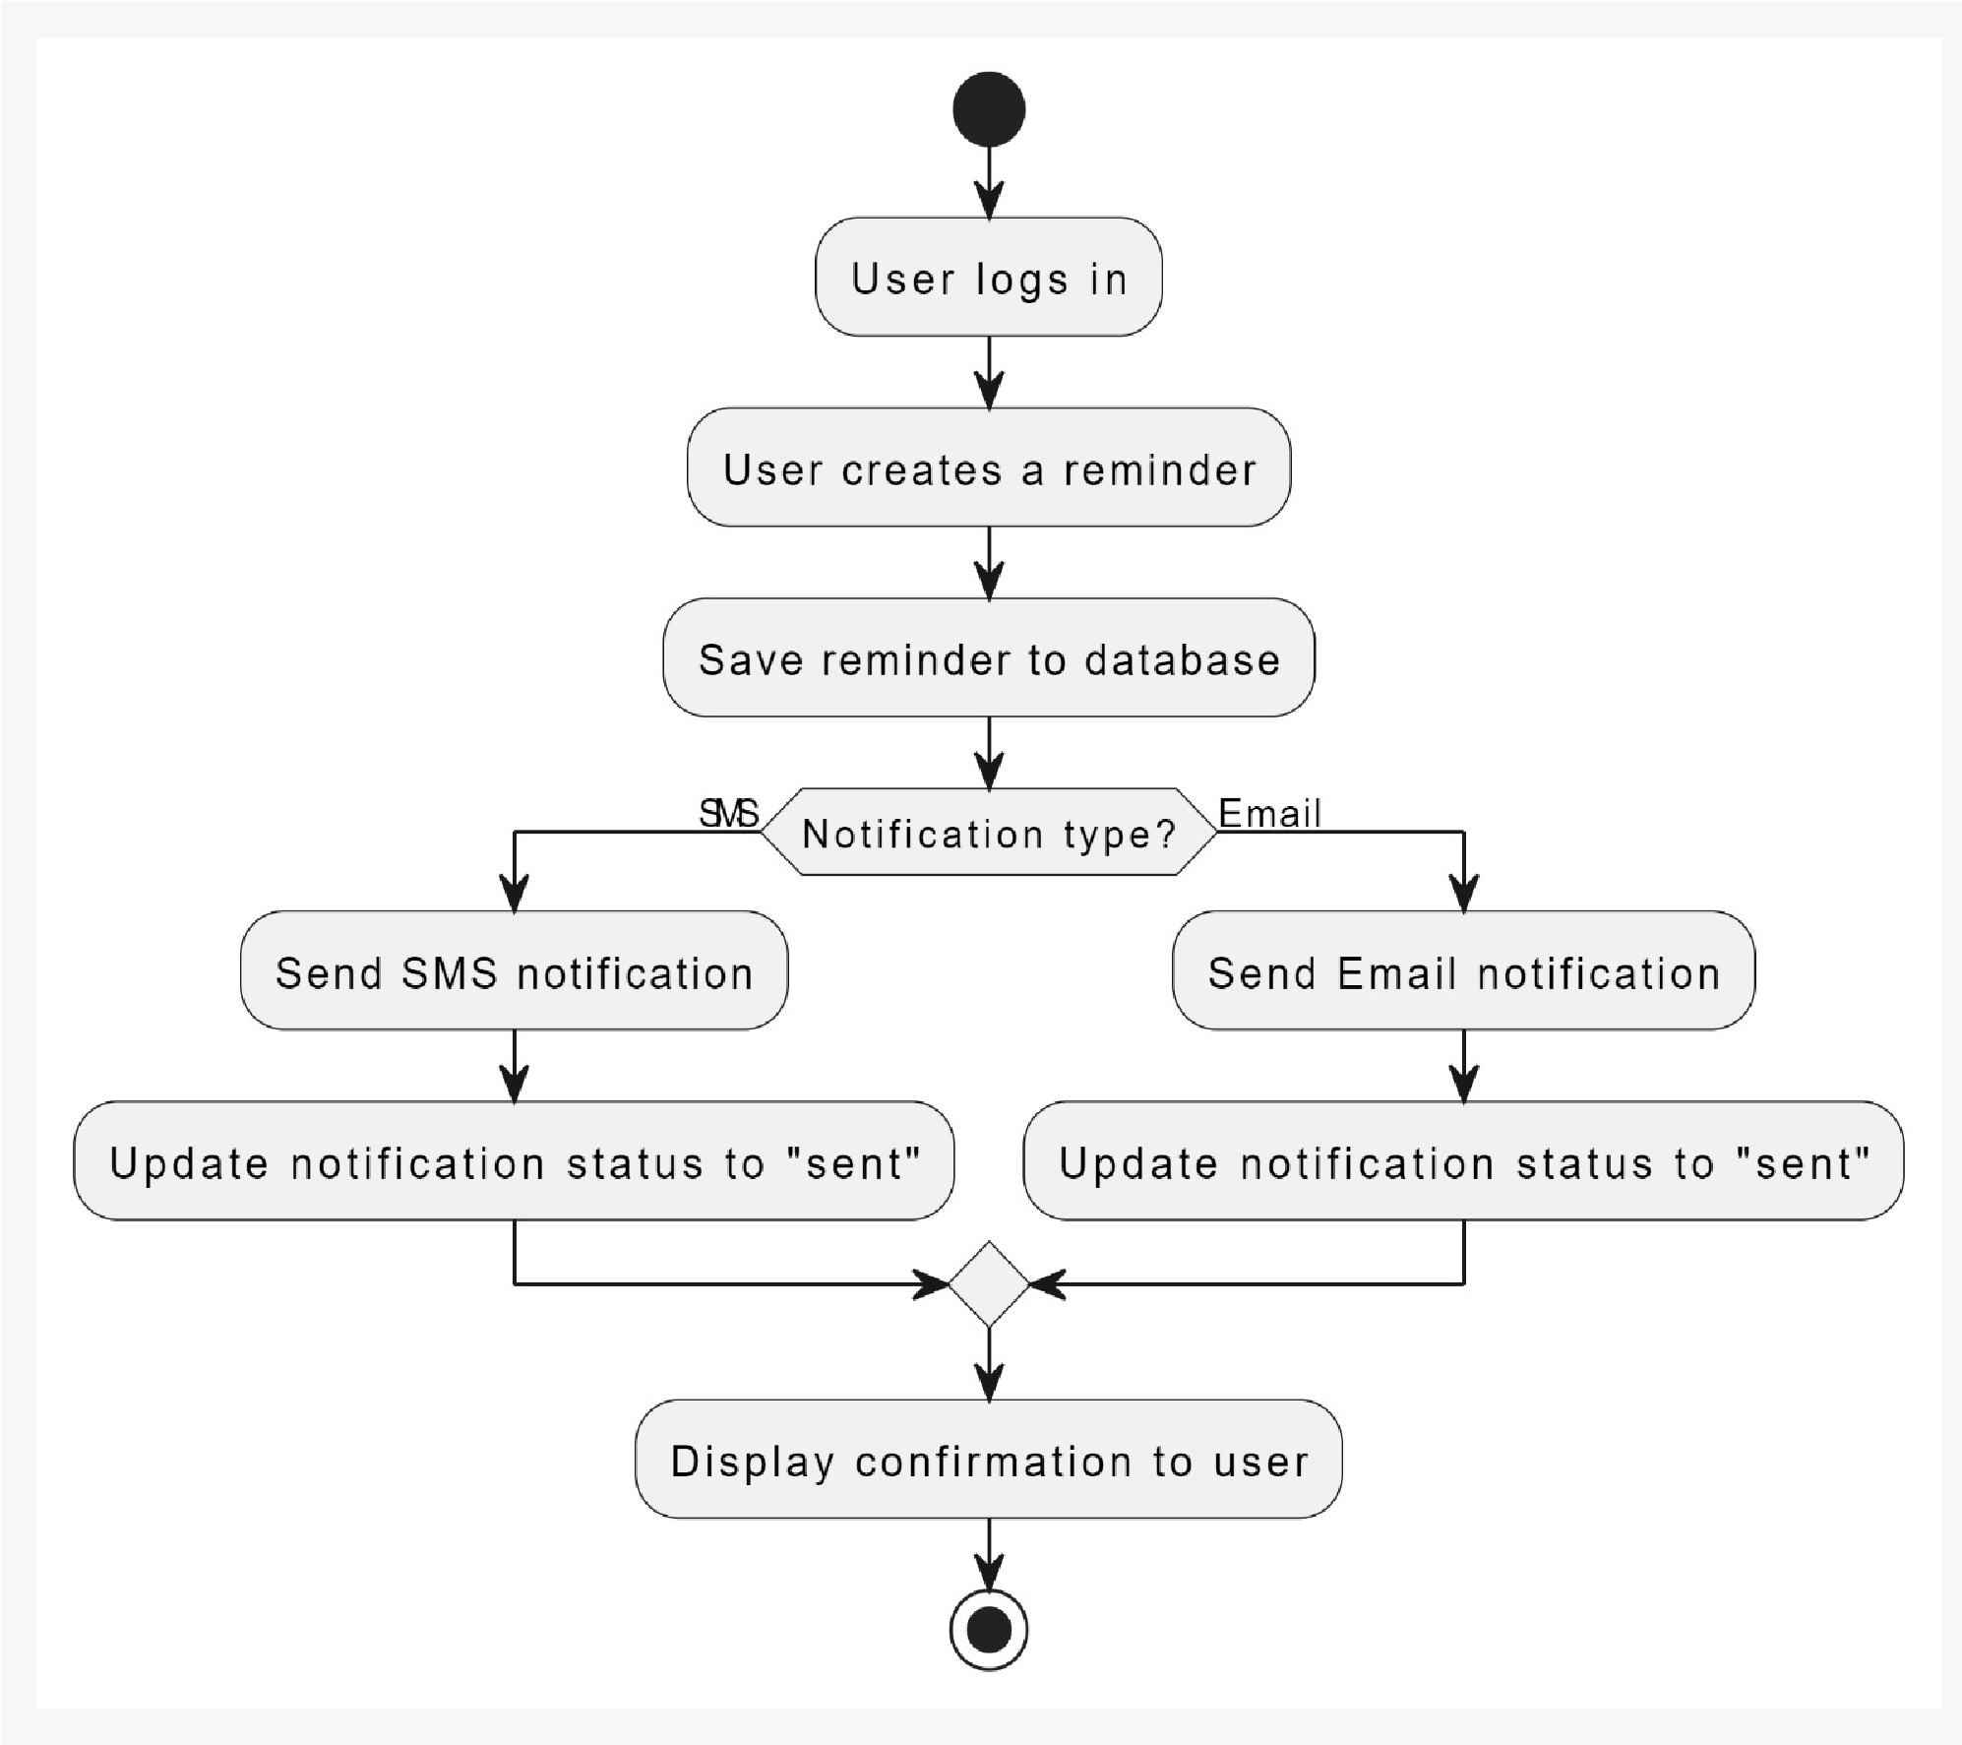

Slide 28
Project Design (Cont.)
Entity Relationship Diagram

Slide 29
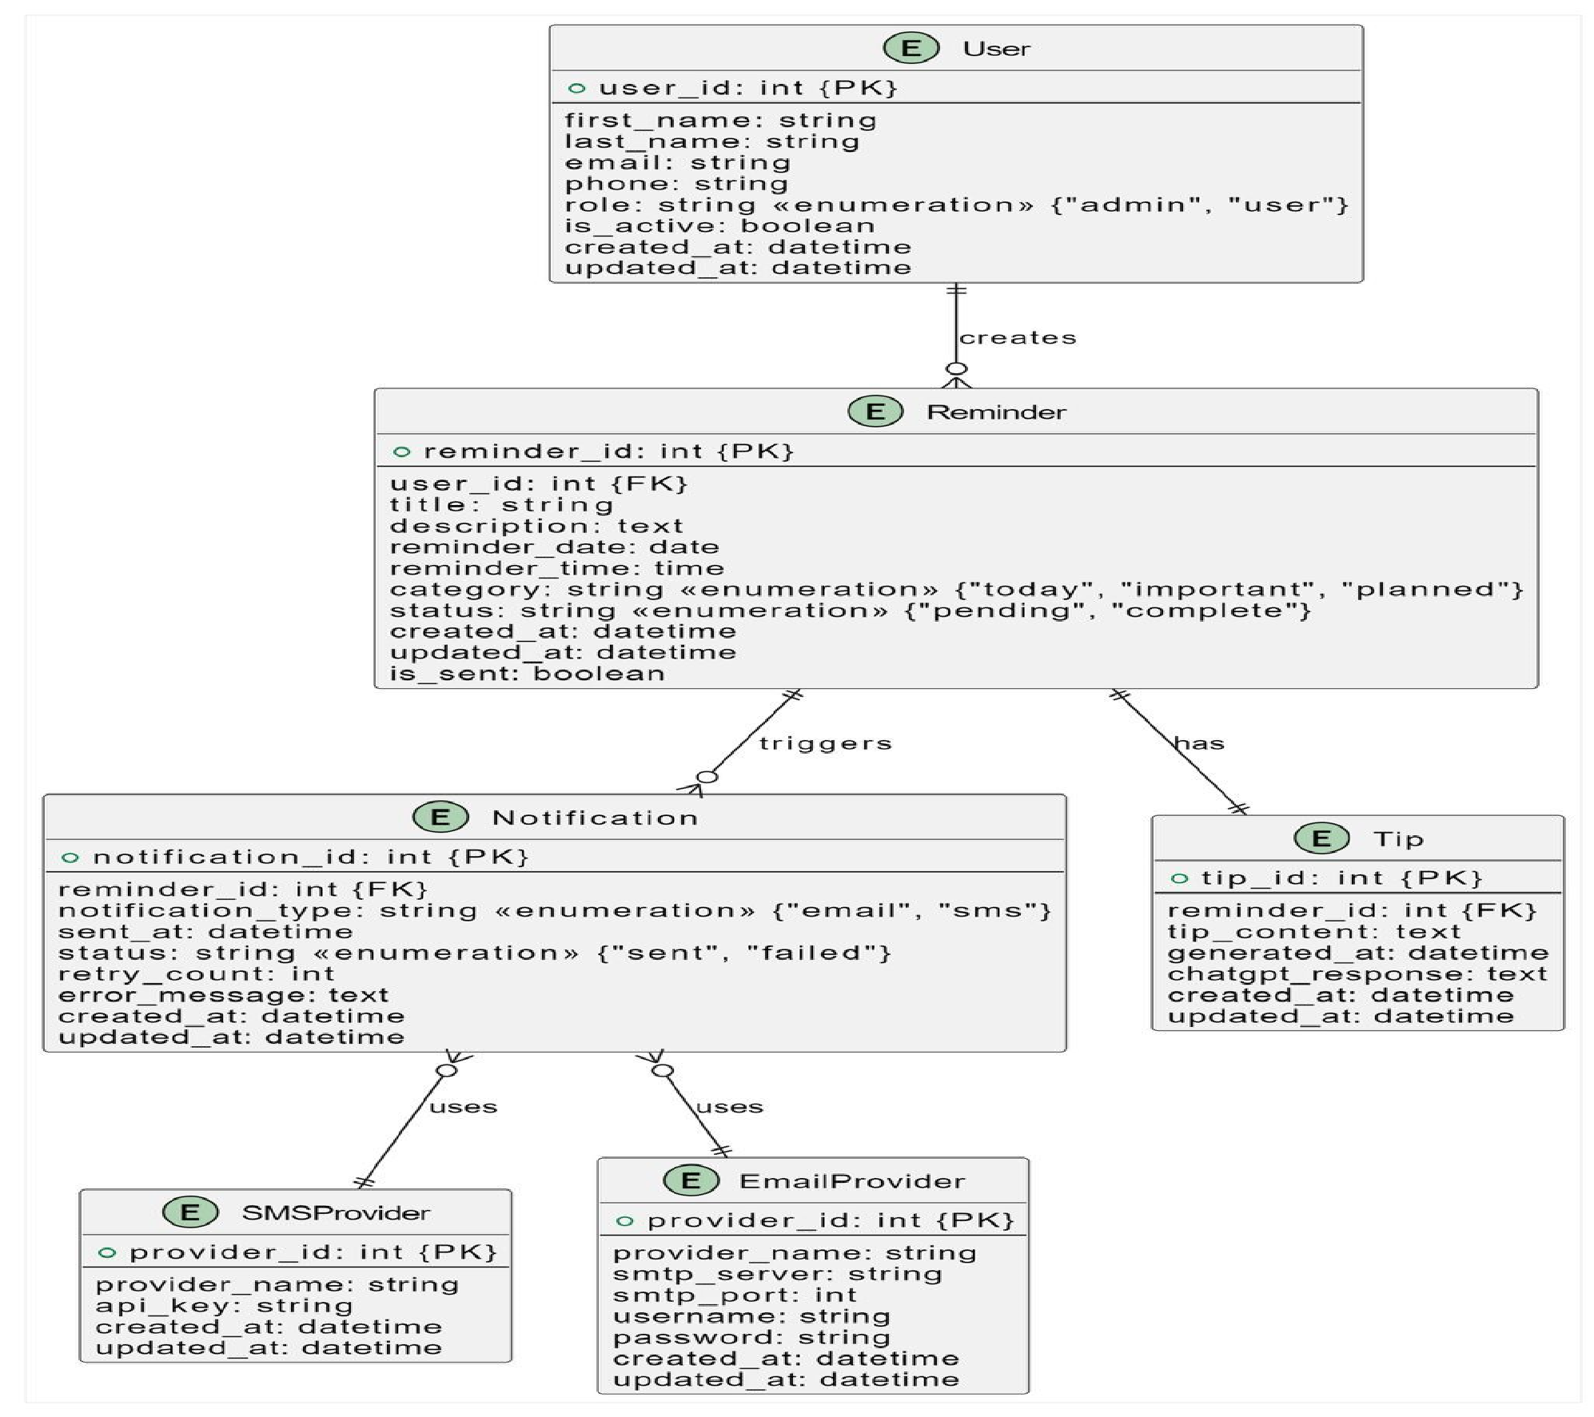

Slide 30
Project Design (Cont.)
Use Case Diagram

Slide 31
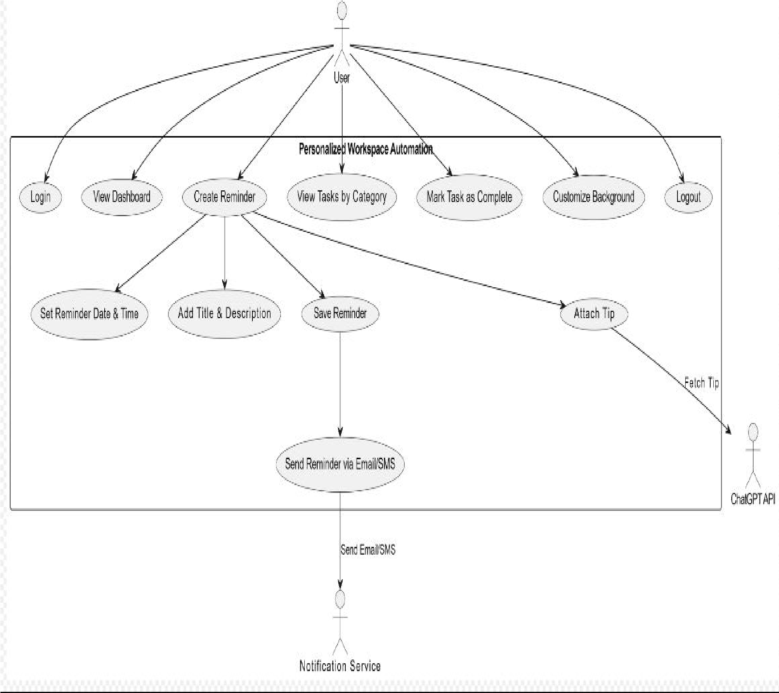

Slide 32
Project Design (Cont.)
Sequence Diagrams

Slide 33
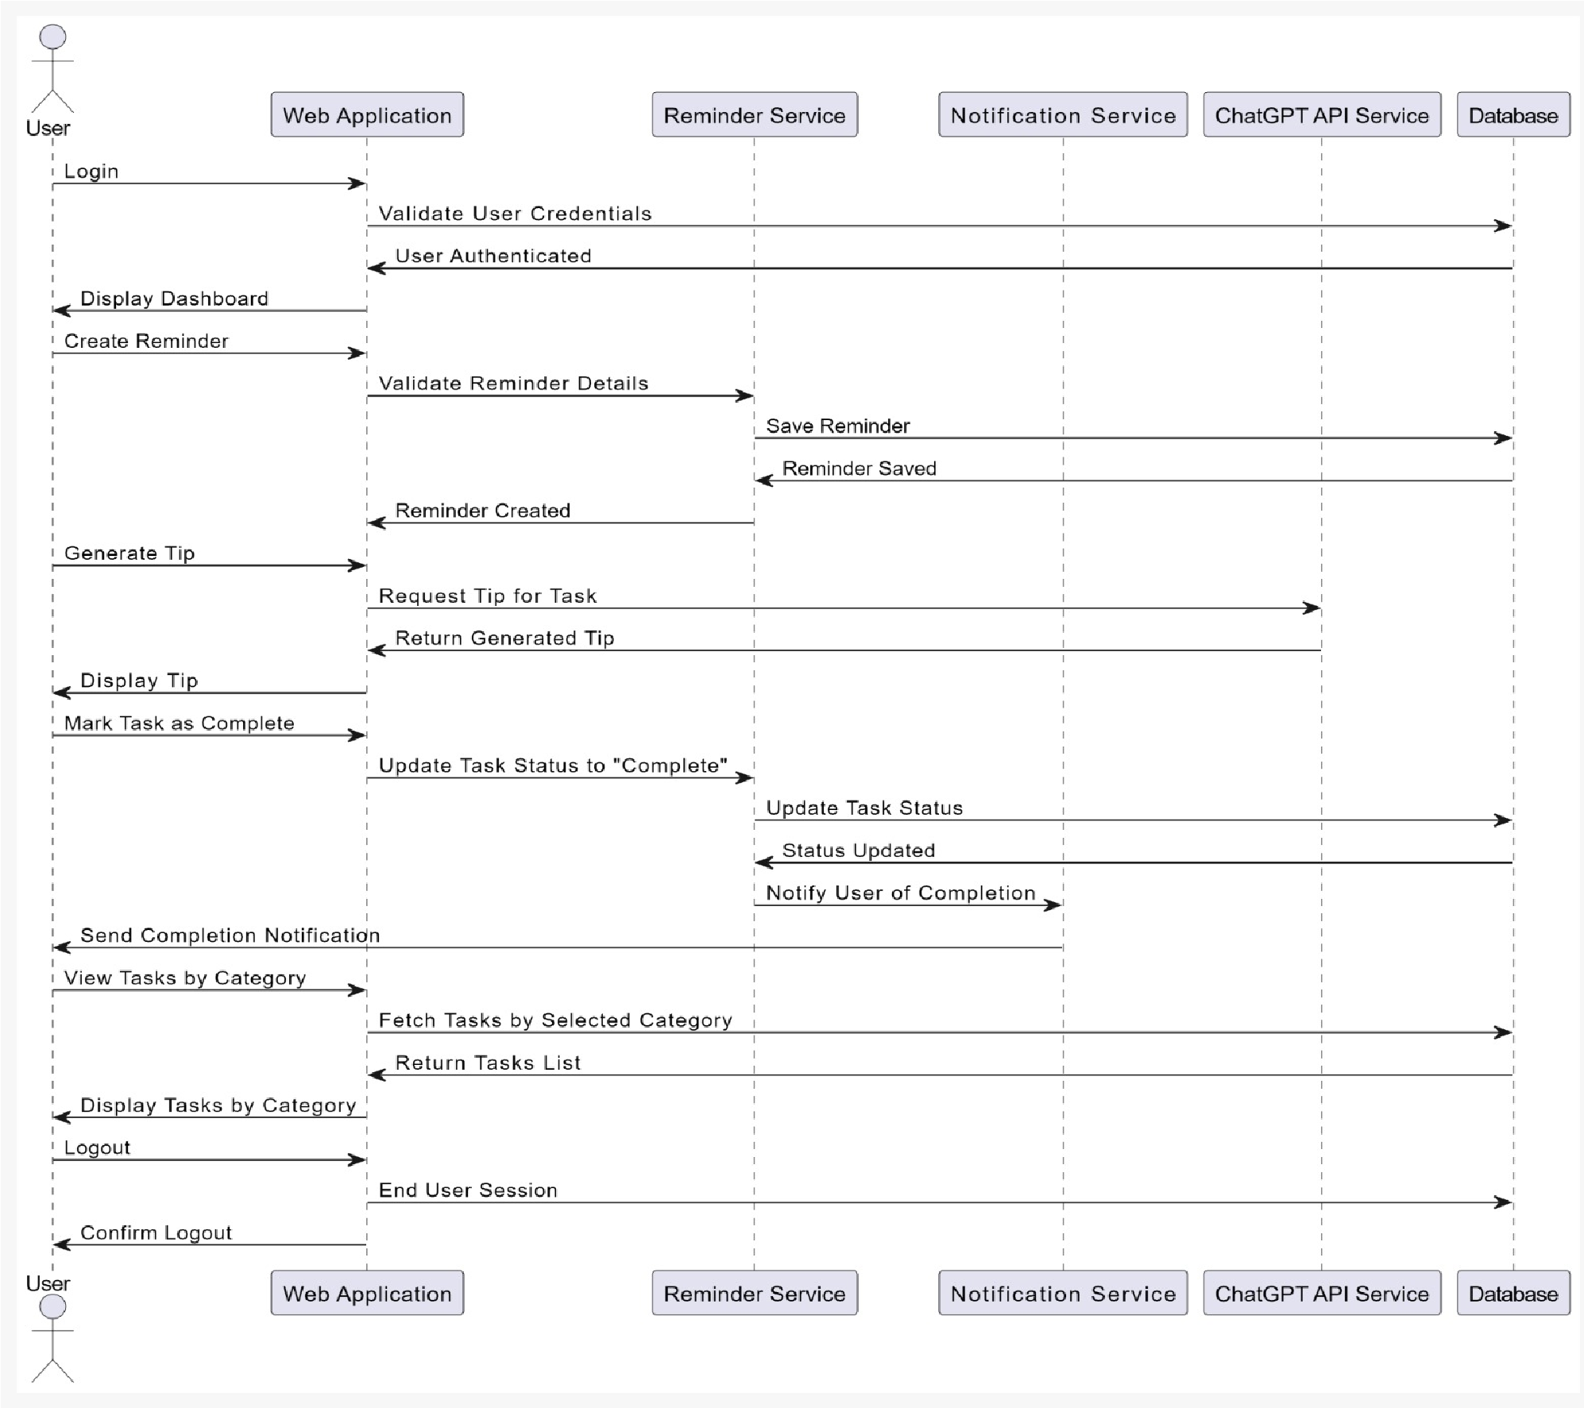

Slide 34
Conclusion
The system provides SMS notification to the user.
The system streamlines task management through automation and real-time AI support, leading to improved workflow efficiency for users.
Automated status updates for completed tasks save time and reduce manual work, allowing users to focus on more critical activities.
The ability to categorize and prioritize tasks in custom ways enables better task tracking and helps users stay organized and goal-focused.
The system offers secure data handling, giving users confidence in protecting their personal and task-related information while using this platform.

Slide 35

Future Work
In the Future, we will enhance the functionality and features of our web applications
which are given below:
The future work for our project involves expanding its capabilities and enhancing the user experience through advanced features and integration with emerging technologies.
There is an opportunity to enhance the application’s mobile responsiveness and develop dedicated mobile apps for iOS and Android to provide a more tailored experience for users on the go.
The scope can be expanded to a large scale by maintaining the database of the User’s work.
Additionally, integrating natural language processing (NLP) could enable users to interact with the system through voice commands or natural language input.
Another area of development is the integration of collaborative features, allowing multiple users to share tasks, reminders and workspace, which would be particularly beneficial for teams and organizations.

Slide 36
Thank you

